Slide 1
Open Pyrojet Driver Circuit
By Michal Lynn

Slide 2
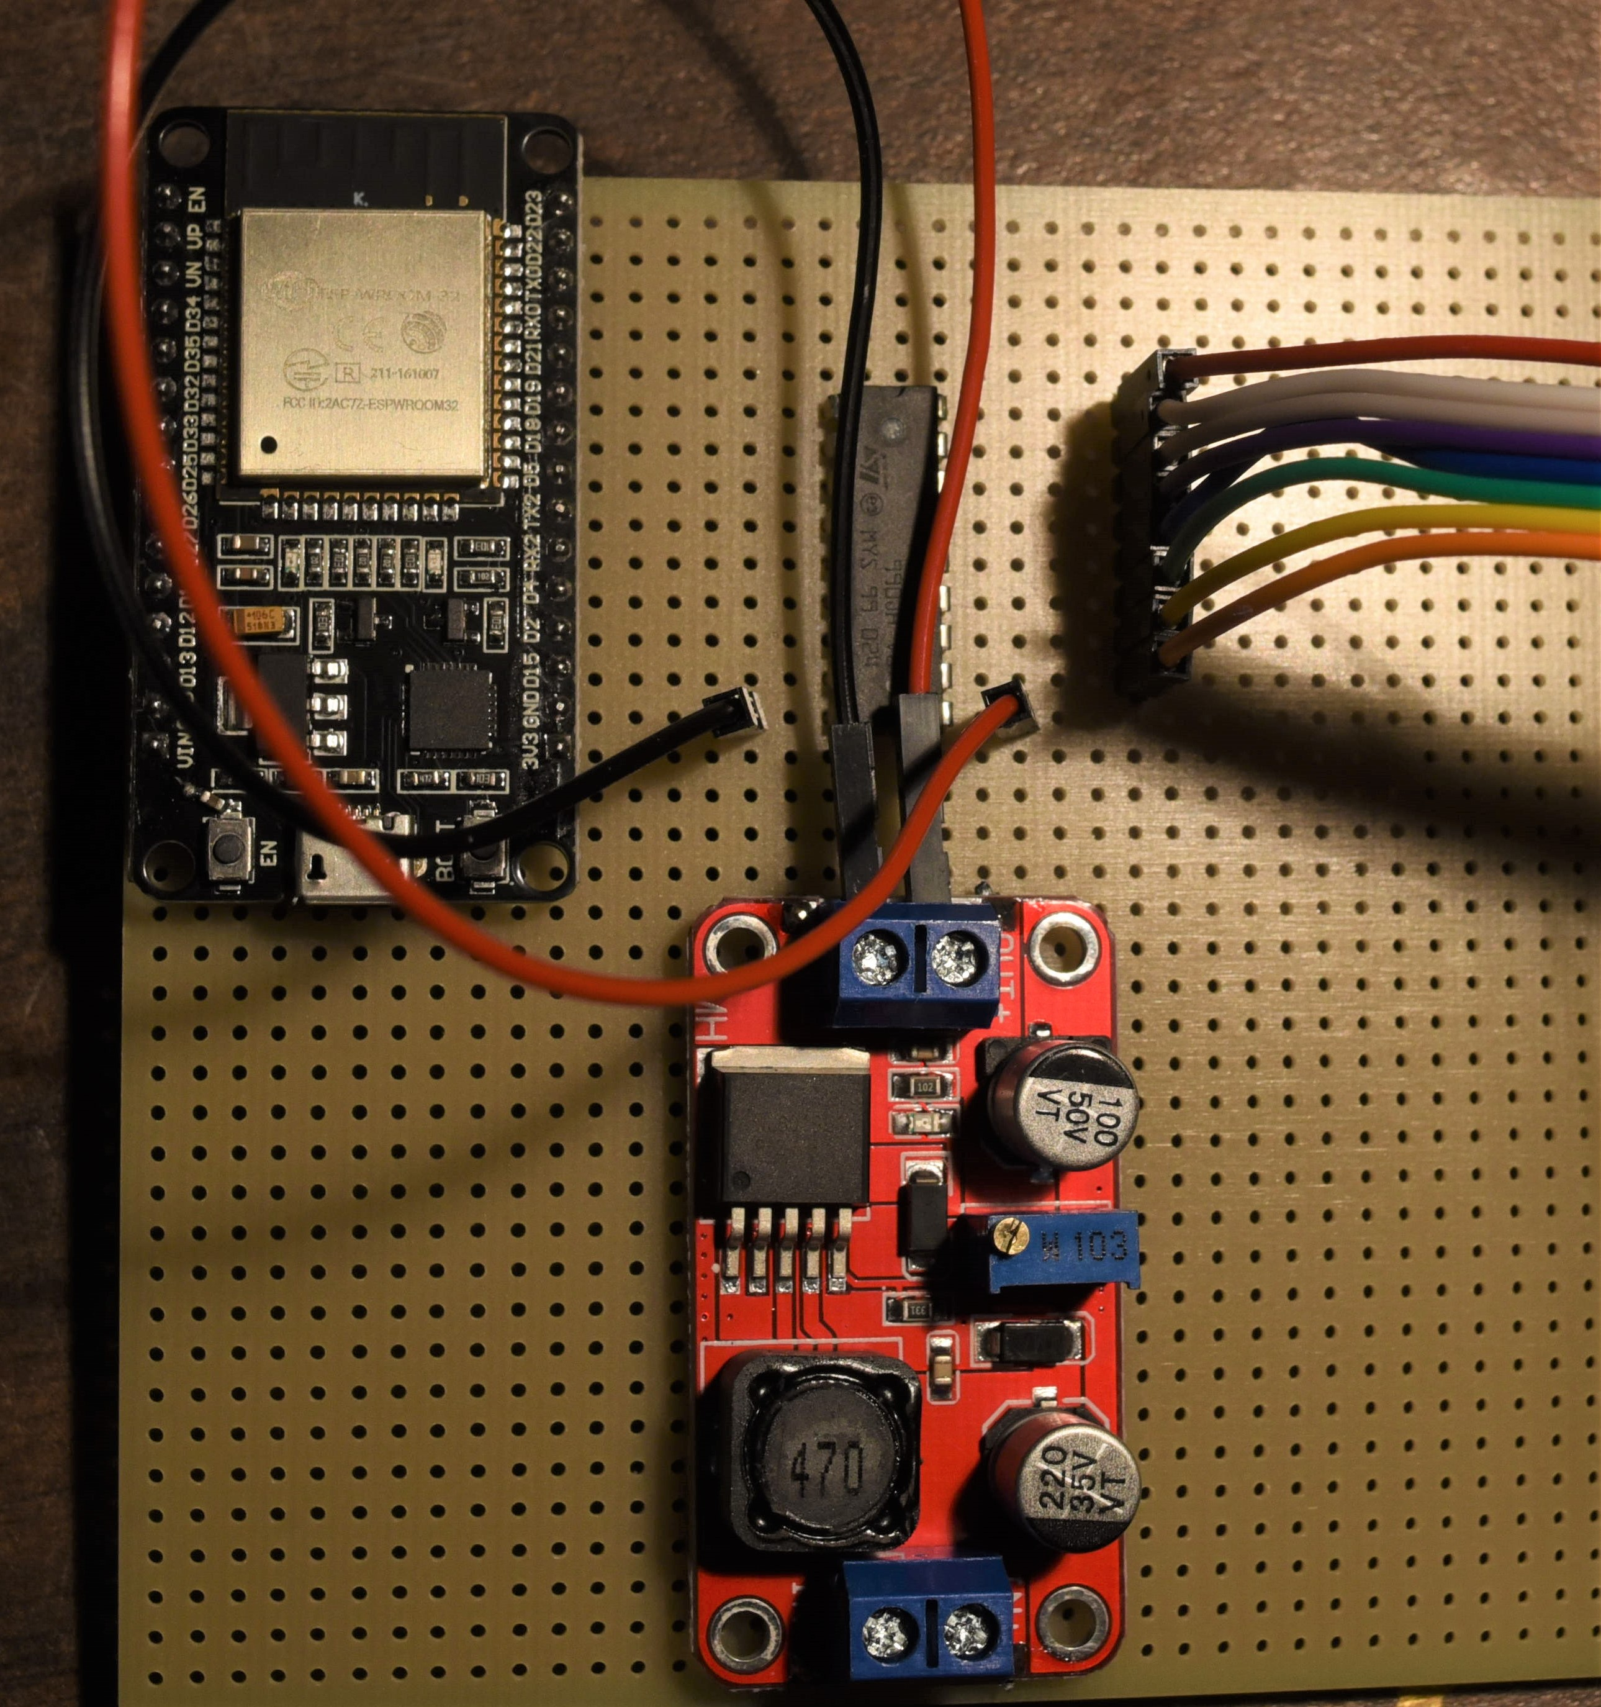
ULN2803A Darlington array
ESP 32
Outputs
XL6019 Converter

Slide 3
Datasheets for assorted components-
https://www.ti.com/product/ULN2803A
https://datasheetspdf.com/pdf/839862/Xlsemi/XL6019/1
https://www.google.com/url?sa=t&rct=j&q=&esrc=s&source=web&cd=&ved=2ahUKEwiR-_y0rbT2AhUikmoFHcuKCrIQFnoECBMQAQ&url=https%3A%2F%2Fwww.espressif.com%2Fsites%2Fdefault%2Ffiles%2Fdocumentation%2Fesp32-wroom-32_datasheet_en.pdf&usg=AOvVaw0mSRlYcJCS3Wtrmh5NsFOT
https://www.mouser.com/datasheet/2/58/BPS-DAT-(ST3U)-Datasheet-771561.pdf

Slide 4
Datasheets for assorted components-
Print Head
SiC Filament
ESP32
ULN2803A
(2)
3-5 V Digital PWM Output
Ground
+ 40 Volts
XL6019
Ground
+ 12/24 Volts

